Slide 1

Legal Marketing Recommendation Strategies for GreenTrail Outdoors
*Optimizing Promotions for Sustainability and Sales Growth
Author: Victoria Lee Date: March 21, 2025
Notes:
Hello, I am Victoria and in today’s meeting I will discussing Legal Marketing Recommendation Strategies for GreenTrail Outdoors.
This should focus on Optimizing Promotions for Sustainability and Sales Growth.
At the end of these strategies recommended, I will provide Emily at GreenTrail to implement these changes
To improve the company’s growth and sustainability goals.
So, let’s get started!

Slide 2

Agenda
Introduction
Data Overview/Analysis
Strategy 1
Strategy 2
Strategy 3
Strategy 4
Control Testing & Methodology
Conclusion
References
Notes:
Today’s agenda is:
Introduction
Data Overview/Analysis
Strategy 1
Strategy 2
Strategy 3
Strategy 4
Control Testing & Methodology
Conclusion
References

Slide 3

Introduction: GreenTrail’s Challenge
GreenTrail Outdoors is facing stagnation in its in-store promotions.
Goal: Improve promotional effectiveness to boost market share, customer engagement, and sales growth.
Analogy: Think of a garden where some plants are thriving, but others are stagnant – GreenTrail needs the right kind of care and nutrients to make all plants flourish.
Notes:
This pptx analyzes GreenTrail Outdoors' promotional data and proposes new marketing strategies to improve sales, customer engagement, and market share. The focus is on identifying the most effective promotional approaches, particularly those that align with GreenTrail’s sustainability goals. Despite the company’s commitment to sustainability, current promotions have been ineffective, leading to stagnation in sales for it’s in store promotions and engagement to keep customers longer. The proposed strategies, such as eco-friendly product bundles and community-driven promotions, aim to drive growth while remaining consistent with GreenTrail's brand ethos. The plan will be monitored for its impact on customer preferences and overall business success.

Slide 4

Data Overview/Analysis:
Discounts: Effective in urban areas (e.g., New York, San Diego).
Buy-One-Get-One: Works well in suburban locations (e.g., Los Angeles).
Special Events: Boosts both sales and engagement, especially in urban locations (e.g., Philadelphia).
Metaphor: Think of each promotion type as a different tool in a toolbox, each working better in specific environments.
Larger stores in urban areas see higher foot traffic and sales boosts from promotions.
Smaller suburban stores need more targeted strategies.
Analogy: Large urban stores are like highways, bustling with traffic, while suburban stores are more like quiet roads that require a different kind of strategy to attract travelers.
Notes:
Upon review of GreenTrail’s store data, it is clear that there are several types of promotions with varied outcomes across different locations. In the Excel data sheet, it has store ID, location, store size, type of promotion, promotion duration, and relevant sales metrics (before, during, and after the promotion). These are the data analysis of the data so far that is noticed.
Promotion Type Impact:
Discounts: In urban locations like New York and San Diego, discount promotions have shown significant increases in weekly sales during the promotion period compared to before, e.g., New York's $30,000 to $50,000, indicating that discounts could drive traffic effectively in larger, high-traffic areas.
Buy-One-Get-One: This promotion type tends to be more effective in suburban locations, as evidenced by Los Angeles, where a slight increase in sales and customer visits was observed during the promotion.
Special Events: Special events generated consistent results, such as in Philadelphia, where weekly sales increased from $31,000 to $49,000, and customer visits also grew by 33%.
Store Size and Type: Larger stores in urban areas tended to see a stronger positive impact from promotions, suggesting that larger stores can better leverage promotions to attract higher foot traffic. Smaller, suburban locations may require more targeted promotions.

Slide 5
|Graphs 1|
Notes:
Promotion Type Impact:
Discounts: In urban locations like New York and San Diego, discount promotions have shown significant increases in weekly sales during the promotion period compared to before, e.g., New York's $30,000 to $50,000, indicating that discounts could drive traffic effectively in larger, high-traffic areas.
Buy-One-Get-One: This promotion type tends to be more effective in suburban locations, as evidenced by Los Angeles, where a slight increase in sales and customer visits was observed during the promotion.
Special Events: Special events generated consistent results, such as in Philadelphia, where weekly sales increased from $31,000 to $49,000, and customer visits also grew by 33%.
Store Size and Type: Larger stores in urban areas tended to see a stronger positive impact from promotions, suggesting that larger stores can better leverage promotions to attract higher foot traffic. Smaller, suburban locations may require more targeted promotions.

Slide 6
|Graphs 2|
Notes:
Promotion Type Impact:
Discounts: In urban locations like New York and San Diego, discount promotions have shown significant increases in weekly sales during the promotion period compared to before, e.g., New York's $30,000 to $50,000, indicating that discounts could drive traffic effectively in larger, high-traffic areas.
Buy-One-Get-One: This promotion type tends to be more effective in suburban locations, as evidenced by Los Angeles, where a slight increase in sales and customer visits was observed during the promotion.
Special Events: Special events generated consistent results, such as in Philadelphia, where weekly sales increased from $31,000 to $49,000, and customer visits also grew by 33%.
Store Size and Type: Larger stores in urban areas tended to see a stronger positive impact from promotions, suggesting that larger stores can better leverage promotions to attract higher foot traffic. Smaller, suburban locations may require more targeted promotions.

Slide 7

Strategy 1: Eco-Friendly Product Bundles
Aligns with GreenTrail’s sustainability goals.
Focus on urban stores to test the concept.
Empathy: Imagine customers’ excitement when they can purchase a sustainable bundle that helps both them and the planet.
Testing Period: 2-week trial for effectiveness.
Notes:
Eco-Friendly Product Bundles (Test & Learn Approach):
GreenTrail should introduce eco-friendly product bundles in select stores, especially urban locations, to align with both sustainability goals and customer preferences for environmentally conscious products.
Testing Duration: A two-week test period, similar to the promotion windows in the data, should be sufficient to gauge the effectiveness of this strategy.

Slide 8

Strategy 2: Increased Focus on Special Events
Events like product launches, eco-tours, and workshops can build community.
These events should emphasize sustainability to reinforce GreenTrail's ethos.
Human Element: Think of a customer who not only buys a product but also feels part of a larger community committed to sustainability.
Notes:
Increased Focus on Special Events:
Special events have demonstrated the ability to boost both sales and customer engagement, particularly in urban stores. GreenTrail should increase the frequency of special events like product launches, sustainability-themed workshops, or eco-tours to drive foot traffic and create a community feel around the brand.
Event Focus: These events should highlight GreenTrail’s commitment to sustainability, ensuring that the messaging is consistent with their brand ethos.

Slide 9

Strategy 3: Localized Discount Campaigns
Discounts worked well in urban areas – now, focus on tailoring campaigns for suburban stores.
Ensure promotions resonate with regional preferences.
Metaphor: A discount is like a key—it opens doors for more customers when used in the right place.
Legal Consideration: Ensure compliance with pricing laws and clearly communicate terms and conditions.
Notes:
Localized Discount Campaigns:
Urban stores showed significant sales boosts during discount promotions. A similar strategy can be implemented for suburban locations but with more localized messaging to ensure the promotion resonates with the customer base in each region.
Legal Considerations: Discount promotions must comply with pricing laws and should not inadvertently create deceptive pricing practices. Proper terms and conditions must be clearly communicated in-store and online.

Slide 10
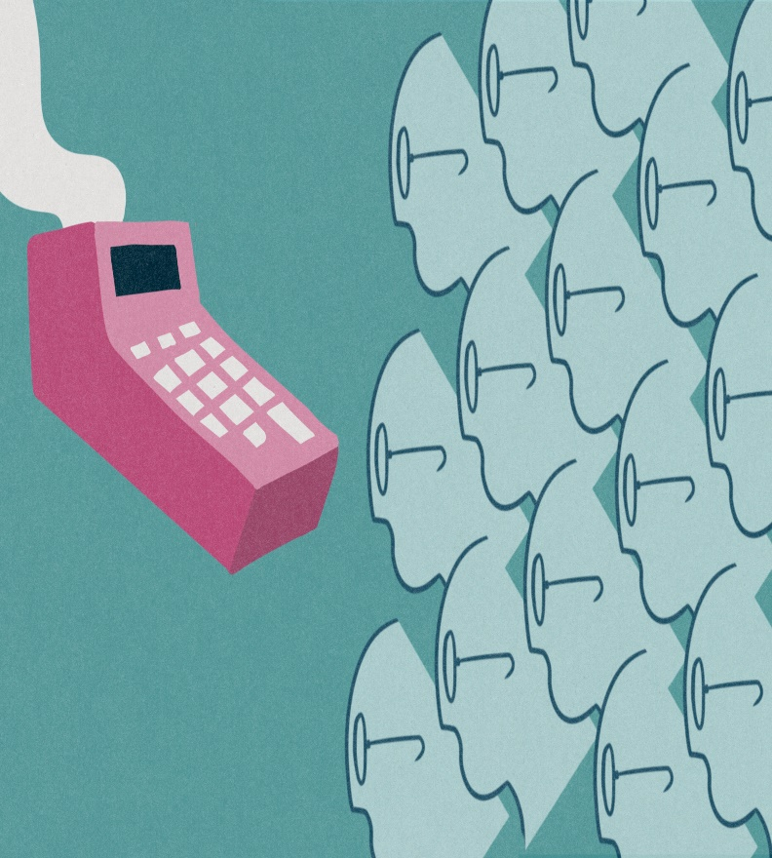
Strategy 4: Personalized Marketing with Customer Data
Use data to offer personalized promotions, such as eco-friendly rewards.
Ensure data collection complies with privacy laws like GDPR and CCPA.
Empathy: Consider a loyal customer who receives personalized offers that make them feel valued and connected to GreenTrail.
Notes:
Leveraging Customer Data for Personalized Marketing:
GreenTrail could invest in a customer loyalty program that tracks purchasing behavior and allows for personalized promotional offers. This program should emphasize eco-friendly rewards or discounts, in line with GreenTrail’s sustainability values.
Privacy Compliance: GreenTrail should ensure that customer data is collected and used in compliance with applicable privacy laws such as the CCPA or GDPR.

Slide 11

Control Testing and Methodology
Use a control group to measure the impact of new strategies.
Track key performance indicators like sales, customer visits, and engagement.
Note: See the graphs showing before-and-after results for stores with new promotions versus control stores.
Notes:
A control group consisting of stores that will not implement the new promotional strategies will help assess the impact of the proposed changes. The testing methodology will focus on key performance indicators (KPIs) such as:
Weekly sales during promotion periods
Average daily visits before, during, and after the promotion
Customer engagement metrics (e.g., loyalty program sign-ups, event attendance)
See the Graphs previously to understand how the control and recommendations were decided included the excel table sheet data.

Slide 12

Conclusion:
Implementing eco-friendly bundles, increasing special events, and localizing discounts will address current stagnation.
These strategies will align with GreenTrail’s sustainability goals and enhance customer engagement.
Call to Action: GreenTrail should act quickly and implement these strategies to position itself as a leader in both sustainability and retail innovation.
Notes:
This strategies analyzes GreenTrail Outdoors' promotional data and proposes strategies to address stagnation in customer engagement and sales.
Key recommendations include introducing eco-friendly product bundles, particularly in urban stores, to align with sustainability goals and customer preferences;
increasing the frequency of special events like product launches and sustainability workshops to boost engagement;
implementing localized discount campaigns tailored to regional customer bases; and utilizing customer data for personalized marketing that emphasizes eco-friendly rewards.
Testing new strategies such as eco-friendly product bundles and increasing the frequency of special events, while ensuring legal compliance and sustainability alignment, will position GreenTrail for greater success in the marketplace.
These strategies aim to enhance GreenTrail's market presence, improve customer interaction, and drive sales while ensuring alignment with the company's sustainability values.

Slide 13
References:
Armstrong, G., & Kotler, P. (2017). Marketing: An introduction (13th ed.). Pearson.
Chaffey, D., & Ellis-Chadwick, F. (2019). Digital marketing (7th ed.). Pearson.
Forge. (n.d.). GreenTrail Store Data Excel Sheet. GreenTrail. https://cdn.theforage.com/vinternships/companyassets/mfxGwGDp6WkQmtmTf/C7cFgPGSnN6JyFEnm/1700721314579/GreenTrail%20Store%20Data.xlsx
Forge. (n.d.). GreenTrail's promotional strategy. The Forage. https://www.theforage.com/virtual-experience/DZxgGgvMB6cEtEyJg/mastercard/advisors-client-services-xvlw/promotion-optimization
Frizbit. (n.d.). Product bundles: The ultimate guide to creating successful bundles. Frizbit. https://frizbit.com/blog/product-bundles-ultimate-guide/
Kotler, P., & Keller, K. L. (2015). Marketing management (15th ed.). Pearson.
Loyalty Magazine. (2020, October 21). The green loyalty opportunity. Loyalty Magazine. https://www.loyaltymagazine.com/the-green-loyalty-opportunity/
Peattie, K., & Crane, A. (2005). Green marketing: Legend, myth, farce or prophecy? Marketing Theory, 5(3), 4-25. https://doi.org/10.1177/1470593105056767
Retail Doc. (n.d.). Better sales through customer engagement. Retail Doc. https://www.retaildoc.com/blog/better-sales-through-customer-engagement
Notes:
This strategies analyzes GreenTrail Outdoors' promotional data and proposes strategies to address stagnation in customer engagement and sales.
Key recommendations include introducing eco-friendly product bundles, particularly in urban stores, to align with sustainability goals and customer preferences;
increasing the frequency of special events like product launches and sustainability workshops to boost engagement;
implementing localized discount campaigns tailored to regional customer bases; and utilizing customer data for personalized marketing that emphasizes eco-friendly rewards.
These strategies aim to enhance GreenTrail's market presence, improve customer interaction, and drive sales while ensuring alignment with the company's sustainability values.
The suggestions are data-driven and testable, ensuring that GreenTrail can measure their effectiveness and adjust accordingly.
Testing new strategies such as eco-friendly product bundles and increasing the frequency of special events, while ensuring legal compliance and sustainability alignment, will position GreenTrail for greater success in the marketplace.

Slide 14
Thank you!
Victoria Lee
123-456-7890
vl0123@greentrail.com
www.greentrail.com
Notes:
Thank you for coming to my presentation and comprehending my strategy plans!
Feel free to contact me if there are any questions or issues
Thank you!
-Best,
Victoria Lee

